Slide 1

WEB-TECH : EDUCATION HUB (WEB DEVELOPMENT PROJECT)
PAAWAN AGRAWAL
RACHIT KHANDELWAL
YASH GUPTA

Slide 2
PRESENTATION OUTLINE
❖ Abstract
❖ Introduction
❖ Background Study
❖ Project Objective
❖ Project Goals
❖ Working Procedure
❖ Testing
❖ Future Scope

Slide 3
ABSTRACT
The objectives of the development of this web-based learning system are to encourage the freedom of self-learning, to promote interaction and cooperation between teachers and students related to different concepts. Because online learning provides flexibility of time ,its work is fast, there is no need of any paper work ,more security of data is there.

Slide 4
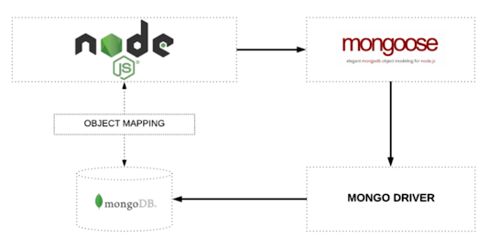

Slide 5
INTRODUCTION
Learning systems properly utilize such capabilities for more effective learning outcomes. In other words, e-learning is the best teaching methods to use for a specific student or group of students knowing that everyone has his/her own learning objectives, motivations, knowledge, and skills. The main objective of this project is to make a website in which user can login , signup ,chat with teachers using CHAT APP ,can give feedbacks and many other things which are needed in e-learning website.

Slide 6
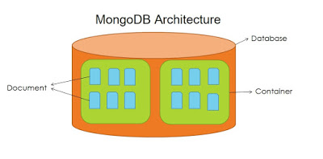

Slide 7

BACKGROUND STUDY
In Present System –
Students have to carry loads of school bag in small age.
Lecture can’t be revised once completed.
It is not scalable.
Cost is high compared to e-learning system.

Slide 8

PROJECT OBJECTIVE
The key objective to support the aims are :
Reduced Costs
Consistency
Scalability
Enhance the quality of learning and teaching. Meet the learning style or needs of students. Improve the efficiency and effectiveness.

Slide 9
LANGUAGES AND TOOLS
Front End Technologies : Html5 ,CSS3, Javascript
Bootstrap4,
Backend End Technologies : Nodejs, Express,Mongoose;
Database : Mongodb
User Interface Design : Visual Studio (Version 1.48)
Deploy : Heruko

Slide 10
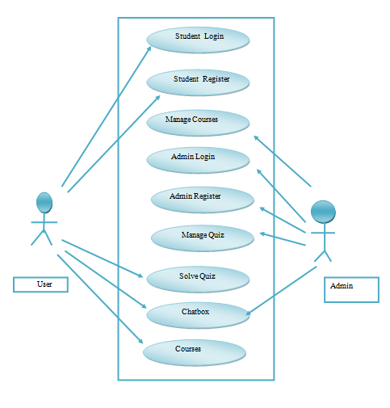
USER CASE DIAGRAM FOR CUSTOMER

Slide 11

WORKING PROCEDURE
Requirement for working procedure:
◆ A PC with windows OS.
◆ HTML and CSS for front end design.
◆ Nodejs, express, for backend.
◆ Visual Studio Code for code writing.
◆ Internet Browser.
◆ mongodb database

Slide 12
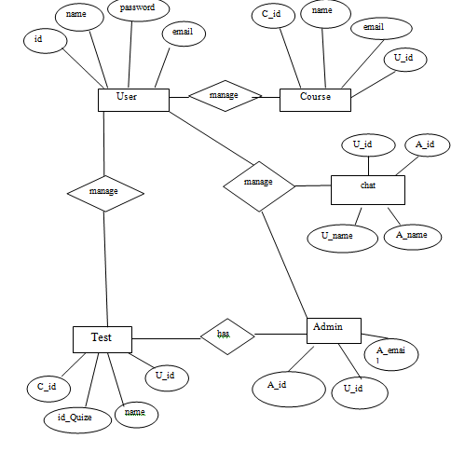
ER DIAGRAM

Slide 13
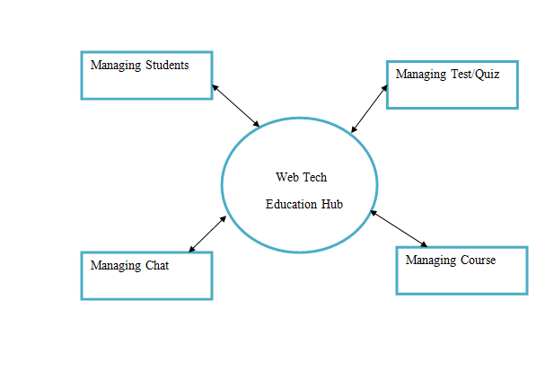
ZERO LEVEL DFD

Slide 14
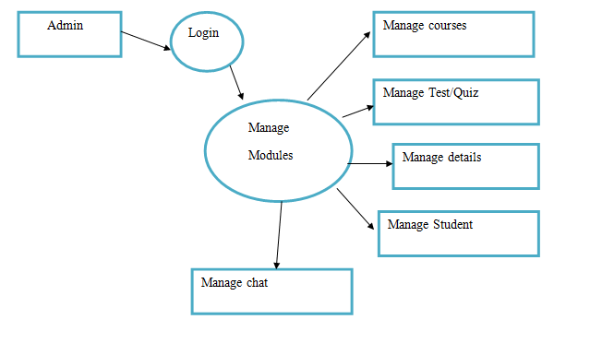
ONE-LEVEL DFD DIAGRAM

Slide 15
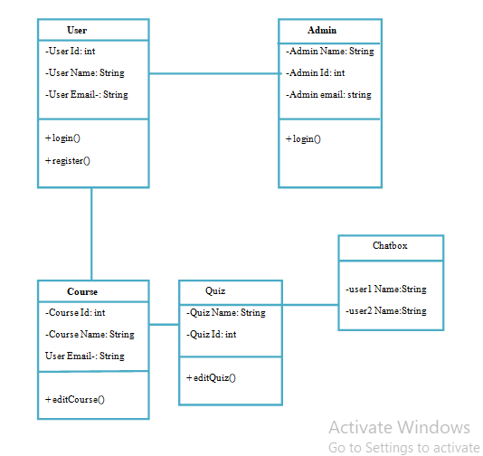
CLASS DIAGRAM

Slide 16
FUTURE SCOPE
E-learning brings unique advantages, the most prominent being the ability for online instructors to provide personalised attention to all students. This is especially critical for those students who cannot afford private face-to-face tutoring sessions or who live in rural areas where such help is not available. In a conventional set up, this is only possible when a highly skilled tutor offers one-to-one tutorials to a student. However, considering that most of the institutions have a classroom-based setup, such individualised attention becomes very difficult.

Slide 17

THANK YOU

